Slide 1


Ahmed Bakhit
2/26/2023

Slide 2

Outline
Executive Summary
Introduction
Methodology
Results
Conclusion
Appendix

Slide 3
Executive Summary
Summary of methodologies
Data Collection with SQL, API, and Web Scraping
Data Analysis and Wrangling
Data Visualization via Interactive Maps
Predictive Analysis Via Machine Learning
Summary of all results
Data Analysis with Visualizations
Best model for Predictive Analysis

Slide 4
Introduction
Project background and context
Our goal is to determine the likelihood of a successful landing for the first stage of the Falcon 9 rocket. This rocket is advertised on SpaceX's website and is priced at 62 million dollars, a significant cost savings compared to other providers whose rockets cost over 165 million dollars each. This cost savings is achieved in part because SpaceX can reuse the first stage of their rocket. By accurately predicting the likelihood of a successful first stage landing, this information can be useful for other companies that may wish to bid against SpaceX for a rocket launch contract.
Problems you want to find answers
With What factors will the rocket land successfully
The effect of each relationship of rocket variables on outcome
Conditions which will aid SpaceX have to achieve the best results

Slide 5

Section 1

Slide 6
Methodology
Executive Summary
Data collection methodology:
Data was collected using Webscarping and API
Perform data wrangling
One-hot encoding was used for categorical features
Perform exploratory data analysis (EDA) using visualization and SQL
Perform interactive visual analytics using Folium and Plotly Dash
Perform predictive analysis using classification models
How to build, tune, evaluate classification models

Slide 7
Data Collection
The SpaceX API was utilized to collect data through a GET request. The response content was decoded as Json using the .json() function and then transformed into a pandas dataframe using .json_normalize(). Following this, the data was cleaned and any missing values were identified and subsequently filled in. Additionally, BeautifulSoup was utilized for web scraping from Wikipedia to extract Falcon 9 launch records. The aim was to extract the launch records as an HTML table, parse the table, and convert it into a pandas dataframe for subsequent analysis.

Slide 8
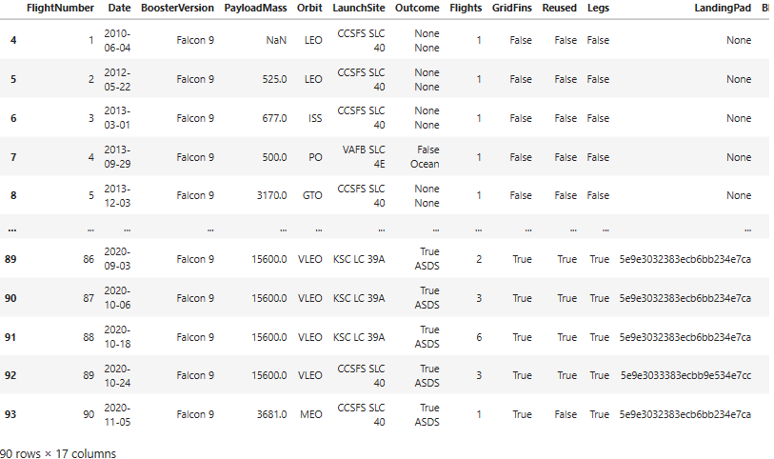
Data Collection – SpaceX API
We used the get request to the SpaceX API to collect data, clean the requested data and did some basic data wrangling and formatting.
Here’s the link: https://eu-de.dataplatform.cloud.ibm.com/analytics/notebooks/v2/84670413-8139-4458-8e7d-edbc2ece9368/view?projectid=d6587a5a-40d8-46d6-b04a-2a562a733026&context=cpdaas

Slide 9
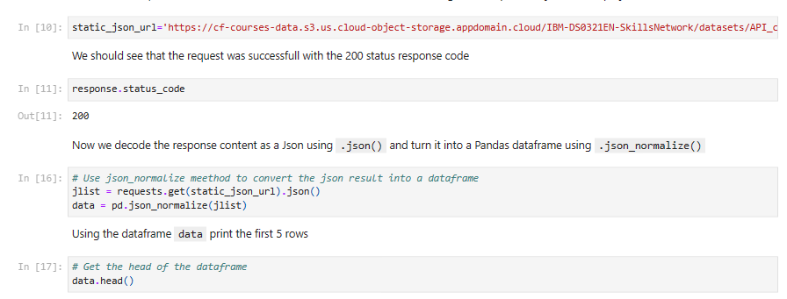
Data Collection - Scraping
We utilized BeautifulSoup for web scraping to extract Falcon 9 launch records. After extracting the data, we parsed the table and transformed it into a pandas dataframe.
Here’s the link: https://eu-de.dataplatform.cloud.ibm.com/analytics/notebooks/v2/84670413-8139-4458-8e7d-edbc2ece9368/view?projectid=d6587a5a-40d8-46d6-b04a-2a562a733026&context=cpdaas

Slide 10
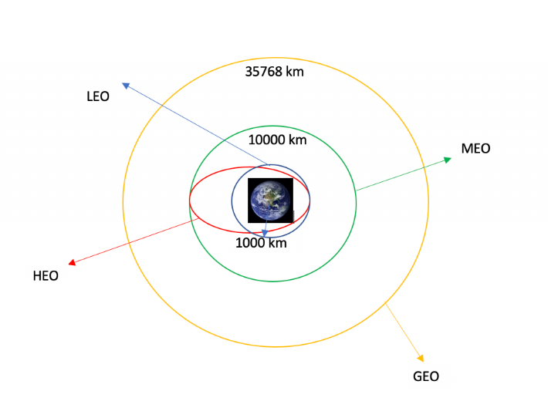
Data Wrangling
After conducting exploratory data analysis, we identified the training labels. Our analysis involved calculating the number of launches that occurred at each site, as well as the number and frequency of launches for each orbit type. We then created a landing outcome label based on the outcome column, and finally exported the results to a csv file.
Here’s the link : https://eu-de.dataplatform.cloud.ibm.com/analytics/notebooks/v2/b3e03f7d-5794-4f7b-ab01-025b237af860/view?projectid=d6587a5a-40d8-46d6-b04a-2a562a733026&context=cpdaas

Slide 11
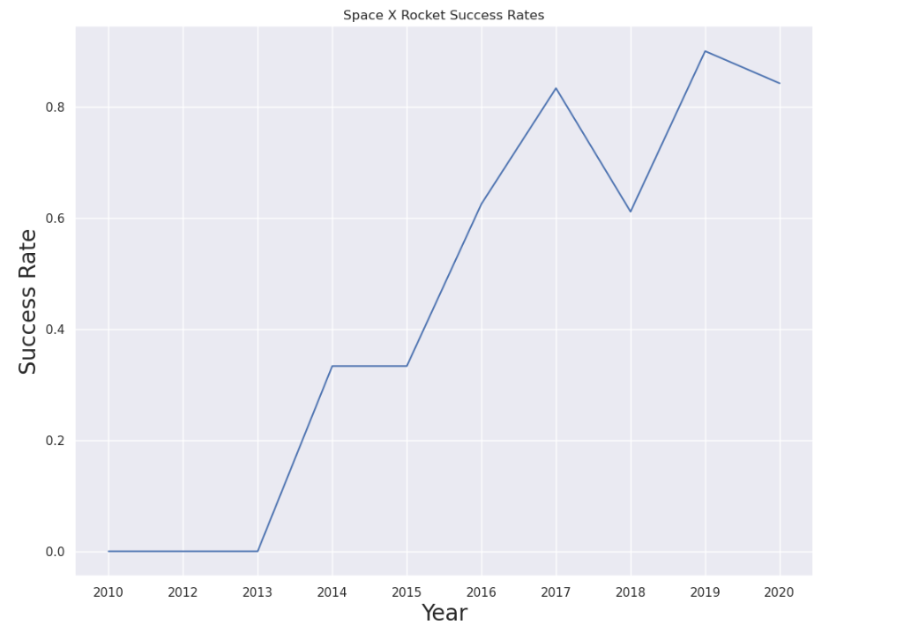
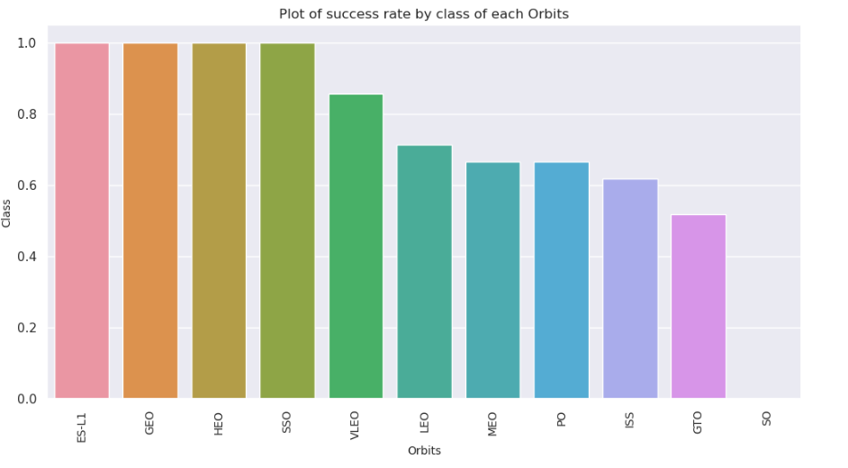
EDA with Data Visualization
Our data exploration involved visualizing several aspects of the data. We examined the relationship between flight number and launch site, as well as between payload and launch site. We also analyzed the success rates of each orbit type and the relationship between flight number and orbit type. Additionally, we investigated the yearly trend in launch success. Link: Data Visulization - IBM Watson Studio

Slide 12
EDA with SQL
In this analysis, we loaded the SpaceX dataset into a PostgreSQL database within the Jupyter notebook environment. We utilized SQL for exploratory data analysis and gained insight from the data by writing queries. Some of the queries included determining the unique names of launch sites, the total payload mass carried by boosters launched by NASA (CRS), the average payload mass carried by booster version F9 v1.1, the total number of successful and failed mission outcomes, and identifying failed landing outcomes in drone ship, along with their corresponding booster version and launch site names.
Link: https://eu-de.dataplatform.cloud.ibm.com/analytics/notebooks/v2/792b7204-c492-4492-87fa-6b25f057ea83/view?projectid=d6587a5a-40d8-46d6-b04a-2a562a733026&context=cpdaas

Slide 13
Build an Interactive Map with Folium
In this analysis, we utilized folium maps to mark all launch sites, and added map objects such as markers, circles, and lines to indicate the success or failure of launches for each site. We assigned the launch outcomes (failure or success) to class 0 and 1, respectively. By using color-labeled marker clusters, we were able to identify launch sites that had a relatively high success rate. Additionally, we calculated the distances between each launch site and its proximities, and answered questions such as whether launch sites were near railways, highways, and coastlines, and whether they kept a certain distance away from cities.
Link: https://eu-de.dataplatform.cloud.ibm.com/analytics/notebook5a-40d8-46d6-b04a-2a562a733026&context=cpdaass/v2/e0b9ecc1-fa05-45b8-beed-0079b0c57e61/view?projectid=d6587a

Slide 14
Build a Dashboard with Plotly Dash
We utilized Plotly Dash to develop an interactive dashboard that included:
Pie charts showcasing the overall number of launches for specific sites.
A scatter plot that depicted the correlation between Outcome and Payload Mass (Kg) for different booster versions.

Slide 15
Predictive Analysis (Classification)
In this analysis, we loaded the data using numpy and pandas, transformed it, and split it into training and testing sets. We then constructed various machine learning models and tuned different hyperparameters using GridSearchCV. The accuracy metric was utilized to evaluate the performance of each model, and we refined the models by utilizing feature engineering and algorithm tuning. Finally, we identified the best-performing classification model.
Link: https://eu-de.dataplatform.cloud.ibm.com/analytics/notebooks/v2/77feb23a-eaa2-47b2-9f1f-afc33805dc13/view?projectid=d6587a5a-40d8-46d6-b04a-2a562a733026&context=cpdaas

Slide 16
Results
Exploratory data analysis results
Interactive analytics demo in screenshots
Predictive analysis results

Slide 17

Section 2

Slide 18
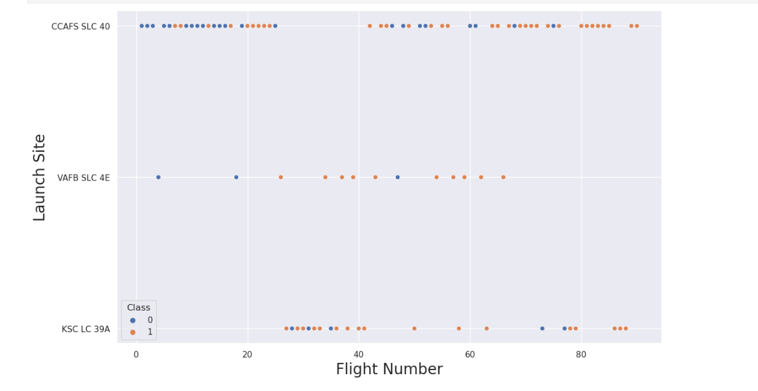
Flight Number vs. Launch Site
Based on the plot, it was observed that as the number of flights increases at a launch site, so does the success rate.

Slide 19
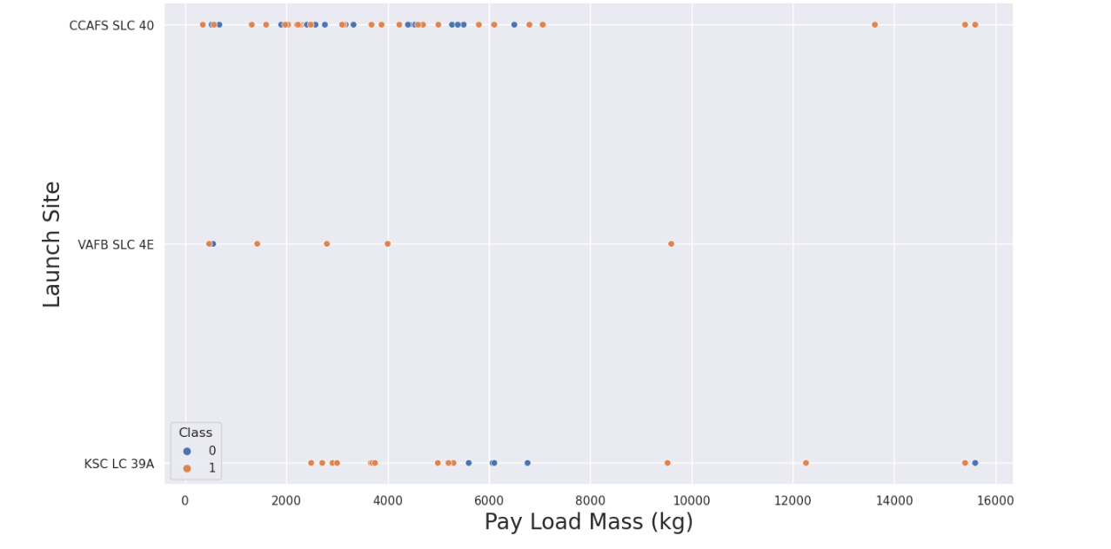
Payload vs. Launch Site
For the launch site CCAFS SLC 40, the higher the payload mass the higher the success rate for the rocket

Slide 20
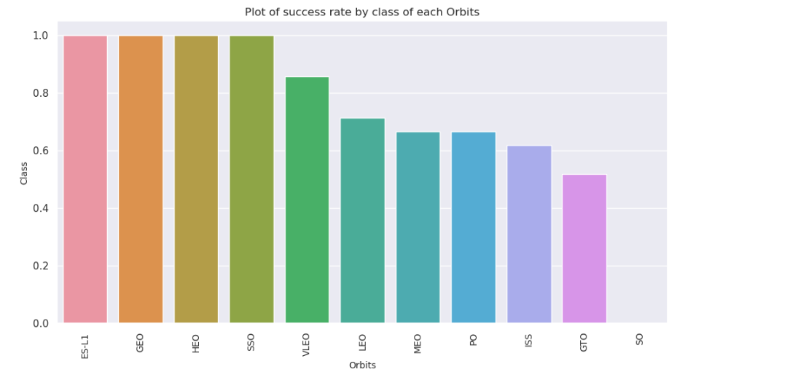
Success Rate vs. Orbit Type
We can observe the success rate by decreasing order

Slide 21
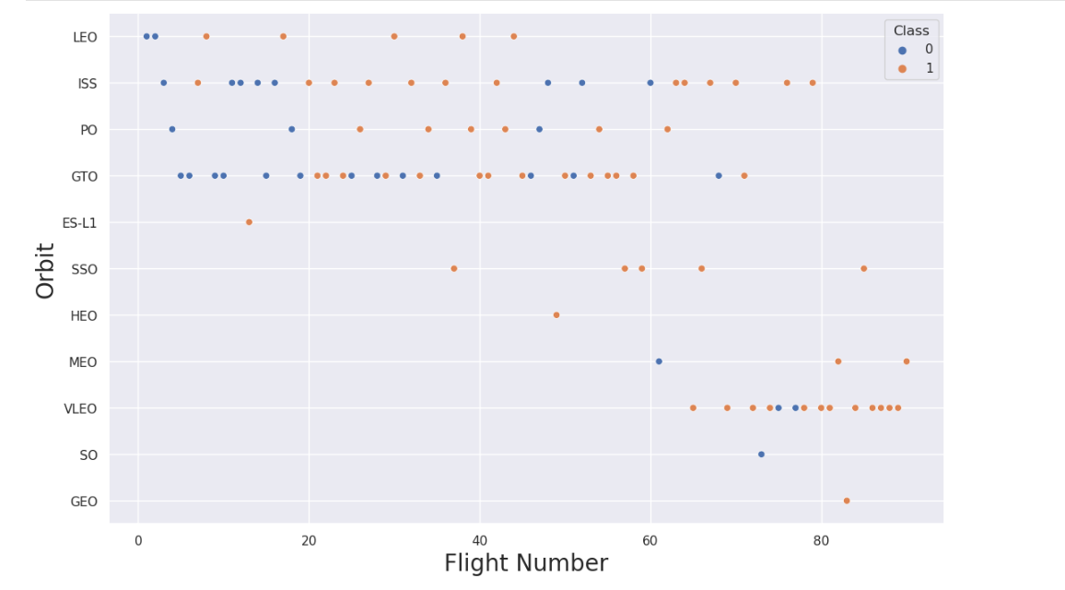
Flight Number vs. Orbit Type
The plot depicted below displays the correlation between Flight Number and Orbit type. It was noticed that for the LEO orbit, success is linked to the number of flights, while for the GTO orbit, there is no discernible association between flight number and the orbit.

Slide 22
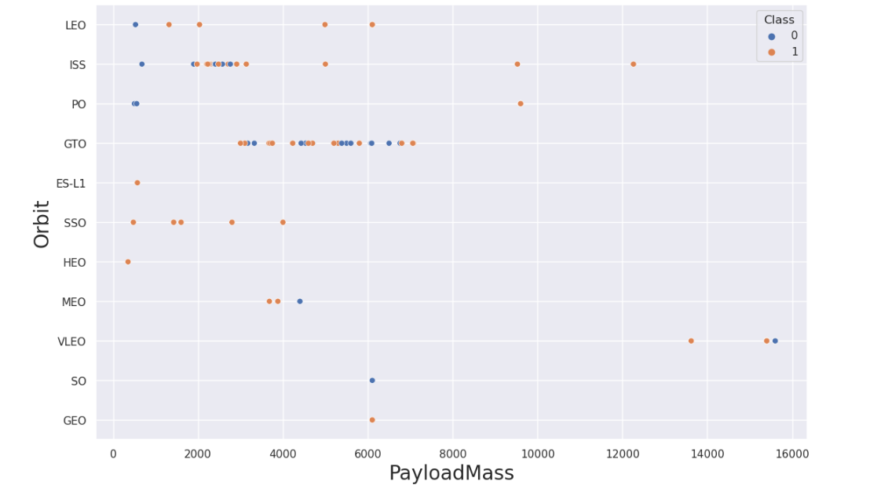
Payload vs. Orbit Type
We can observe that with heavy payloads, the successful landing are more for PO, LEO and ISS orbits.

Slide 23
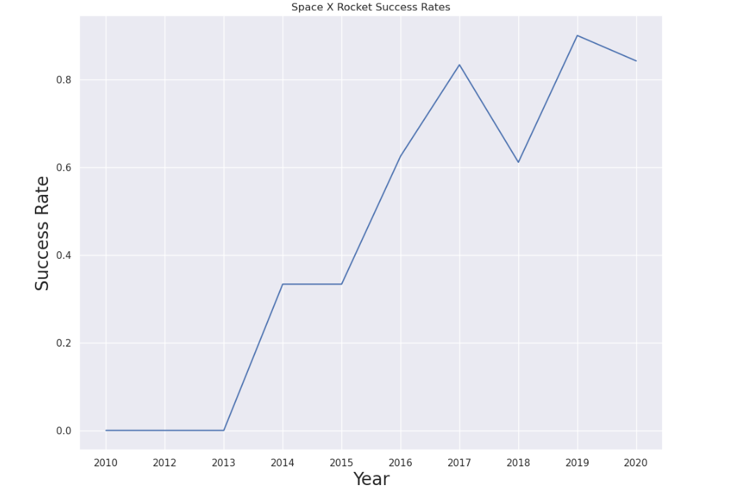
Launch Success Yearly Trend
We can observe that the success rate is increasing from 2013

Slide 24
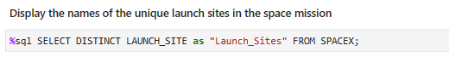
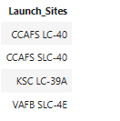
All Launch Site Names

Slide 25
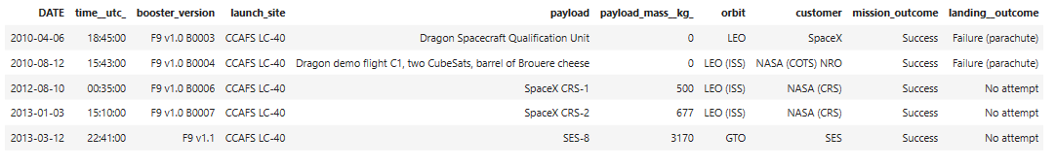
Launch Site Names Begin with 'CCA'
We used the query below to display 5 records where launch sites begin with `CCA`

Slide 26
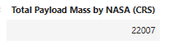
Total Payload Mass
We calculated the total payload carried by boosters from NASA as 45596 using the above

Slide 27
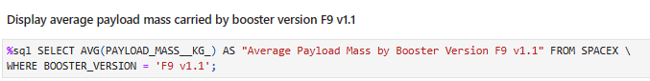
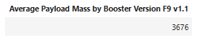
Average Payload Mass by F9 v1.1
We calculated the average payload mass carried by booster version F9 v1.1 below

Slide 28
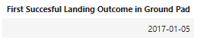
First Successful Ground Landing Date
We can observe the first successful land date below

Slide 29
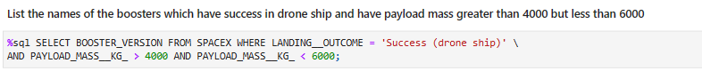
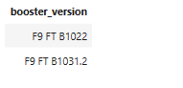
Successful Drone Ship Landing with Payload between 4000 and 6000
To identify boosters that have successfully landed on the drone ship, we employed the WHERE clause and then utilized the AND condition to specify a successful landing with a payload mass between 4000 and 6000.

Slide 30
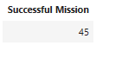
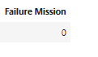
Total Number of Successful and Failure Mission Outcomes
To filter for cases where the MissionOutcome was either a success or a failure, we employed the wildcard character '%'.

Slide 31

Boosters Carried Maximum Payload
We observe Boosters with Maximum Payload

Slide 32

2015 Launch Records
We observe below the 2015 Launch Records

Slide 33

Rank Landing Outcomes Between 2010-06-04 and 2017-03-20
We retrieved the Landing outcomes and the COUNT of landing outcomes from the dataset and filtered for the landing outcomes that occurred between 2010-06-04 and 2010-03-20 using the WHERE clause. We then grouped the landing outcomes using the GROUP BY clause and arranged them in descending order using the ORDER BY clause.

Slide 34

Section 3

Slide 35
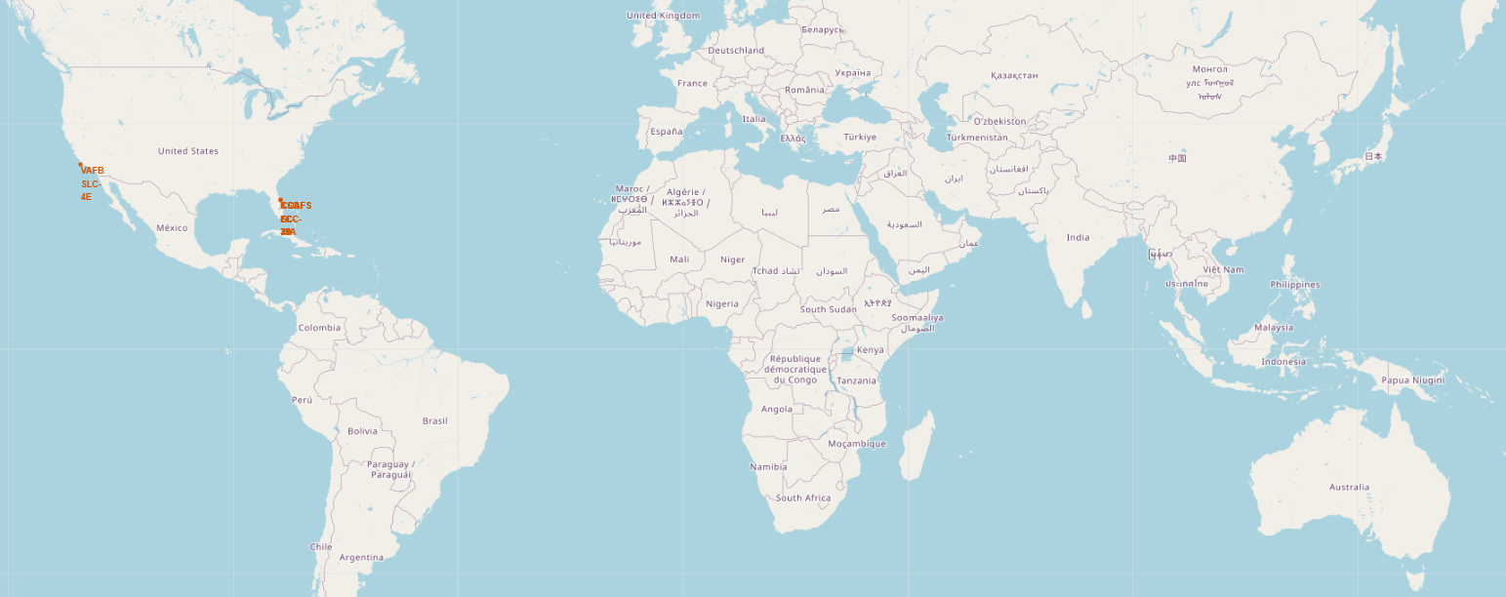
Launch Sites With Global Map Markers
It is observed that the markers are only in the US Coasts

Slide 36
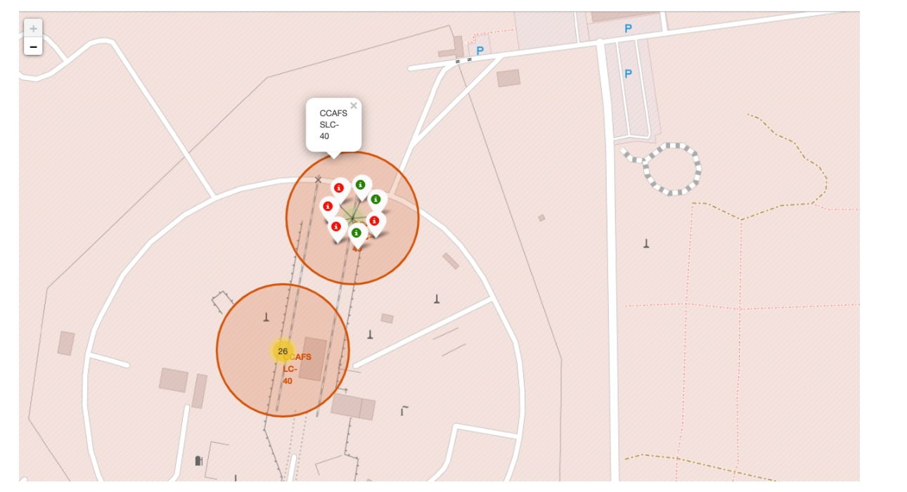
Launch sites with color labels

Slide 37
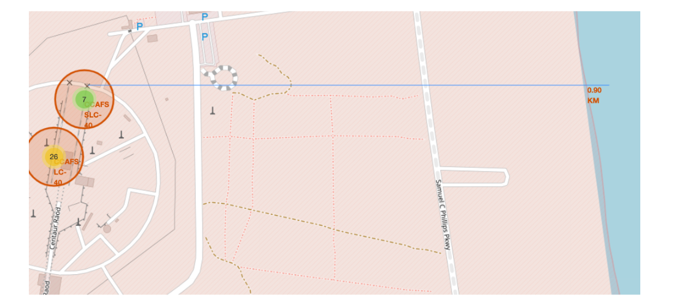
Launch Site with distance to Shore

Slide 38

Section 4

Slide 39
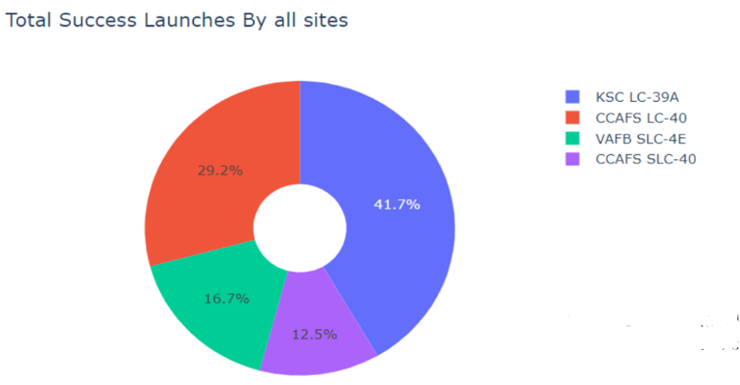
Success Percentage Pie Chart
KSC LC 38A has the most success

Slide 40
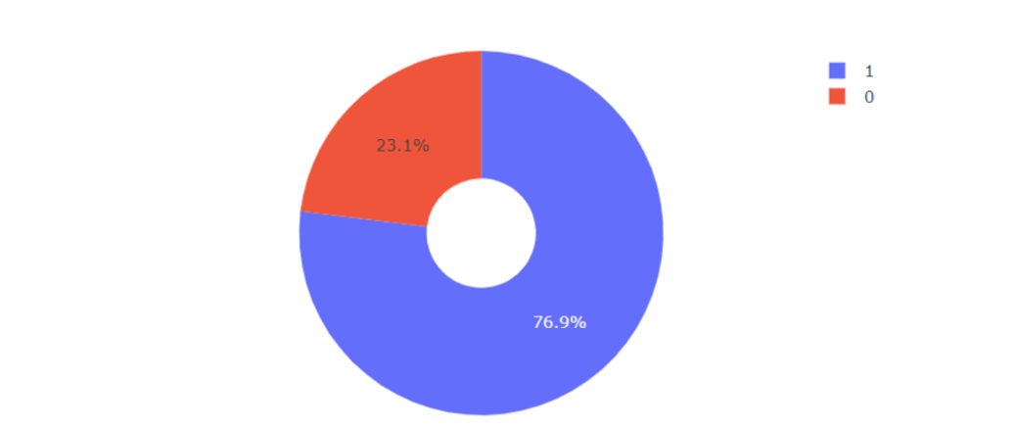
Highest Launch success ratio
Pie chart with the most success ratio

Slide 41
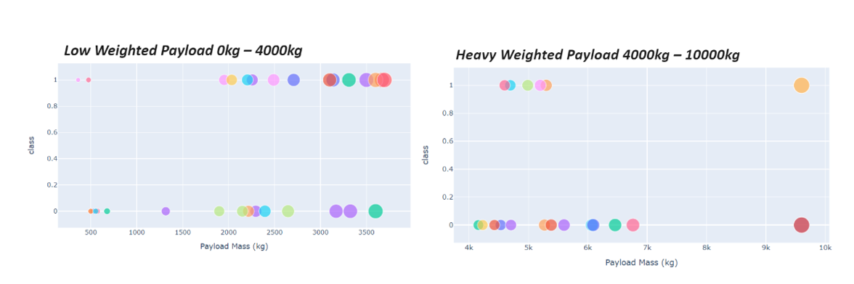
Scatter plot of Payload vs Launch Outcome for all sites, with different payload selected in the range slider
It is observed that low weighted payload has more success than heavy weighted payload

Slide 42

Section 5

Slide 43
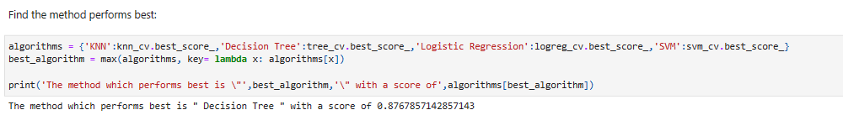
Classification Accuracy
Below is the algorithm that has the best accuracy

Slide 44
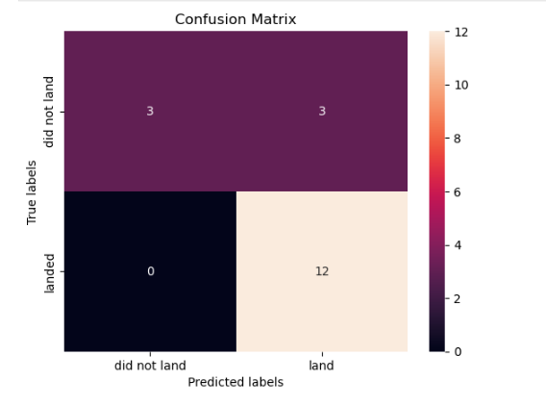
Confusion Matrix
The decision tree classifier's confusion matrix indicates that it can differentiate between the various classes. However, it has a significant issue with false positives, which refers to the classifier marking an unsuccessful landing as a successful one

Slide 45
Conclusions
There is a positive correlation between the number of flights at a launch site and the success rate.
The launch success rate has been increasing since 2013 up until 2020.
Orbits such as ES-L1, GEO, HEO, SSO, and VLEO had the highest success rates.
Among all launch sites, KSC LC-39A had the highest number of successful launches.
The Decision tree classifier was found to be the most effective machine learning algorithm for this particular task.

Slide 46


